Slide 1
Simulation
ISE
UTK
Dr. Xueping Li
University of Tennessee
Appendix C – A Refresher on Probability and Statistics
Slide <number> of 34

Slide 2
A Refresher on Probability and Statistics
Appendix C
Simulation with Arena, 4/e
Appendix C – A Refresher on Probability and Statistics
Slide <number> of 34

Slide 3
What We’ll Do ...
Ground-up review of probability and statistics necessary to do and understand simulation
Assume familiarity with
  Algebraic manipulations
  Summation notation
  Some calculus ideas (especially integrals)
Outline
  Probability – basic ideas, terminology
  Random variables, joint distributions
  Sampling
  Statistical inference – point estimation, confidence intervals, hypothesis testing
Simulation with Arena, 4/e
Appendix C – A Refresher on Probability and Statistics
Slide <number> of 34

Slide 4
Probability Basics
Experiment – activity with uncertain outcome
  Flip coins, throw dice, pick cards, draw balls from urn, …
  Drive to work tomorrow – Time? Accident?
  Operate a (real) call center – Number of calls? Average customer hold time? Number of customers getting busy signal?
  Simulate a call center – same questions as above
Sample space – complete list of all possible individual outcomes of an experiment
  Could be easy or hard to characterize
  May not be necessary to characterize
Simulation with Arena, 4/e
Appendix C – A Refresher on Probability and Statistics
Slide <number> of 34

Slide 5
Probability Basics (cont’d.)
Event – a subset of the sample space
  Describe by either listing outcomes, “physical” description, or mathematical description
  Usually denote by E, F, E₁, E₂, etc.
  Union, intersection, complementation operations
Probability of an event is the relative likelihood that it will occur when you do the experiment
  A real number between 0 and 1 (inclusively)
  Denote by P(E), P(E ∩ F), etc.
  Interpretation – proportion of time the event occurs in many independent repetitions (replications) of the experiment
  May or may not be able to derive a probability
Simulation with Arena, 4/e
Appendix C – A Refresher on Probability and Statistics
Slide <number> of 34

Slide 6

Probability Basics (cont’d.)
Some properties of probabilities
  If S is the sample space, then P(S) = 1
    Can have event E ≠ S with P(E) = 1
  If Ø is the empty event (empty set), then P(Ø) = 0
    Can have event E ≠ Ø with P(E) = 0
  If E^{C} is the complement of E, then P(E^{C}) = 1 – P(E)
  P(E ∪ F) = P(E) + P(F) – P(E ∩ F)
  If E and F are mutually exclusive (i.e., E ∩ F = Ø), then P(E ∪ F) = P(E) + P(F)
  If E is a subset of F (i.e., the occurrence of E implies the occurrence of F), then P(E) ≤ P(F)
  If o₁, o₂, … are the individual outcomes in the sample space, then
Simulation with Arena, 4/e
Appendix C – A Refresher on Probability and Statistics
Slide <number> of 34

Slide 7

Probability Basics (cont’d.)
Conditional probability 
  Knowing that an event F occurred might affect the probability that another event E also occurred
  Reduce the effective sample space from S to F, then measure “size” of E relative to its overlap (if any) in F, rather than relative to S
  Definition (assuming P(F) ≠ 0):
E and F are independent if P(E ∩ F) = P(E) P(F)
  Implies P(E|F) = P(E) and P(F|E) = P(F), i.e., knowing that one event occurs tells you nothing about the other
  If E and F are mutually exclusive, are they independent?
Simulation with Arena, 4/e
Appendix C – A Refresher on Probability and Statistics
Slide <number> of 34

Slide 8
Random Variables
One way of quantifying, simplifying events and probabilities
A random variable (RV) is a number whose value is determined by the outcome of an experiment
  Technically, a function or mapping from the sample space to the real numbers, but can usually define and work with a RV without going all the way back to the sample space
  Think: RV is a number whose value we don’t know for sure but we’ll usually know something about what it can be or is likely to be
  Usually denoted as capital letters: X, Y, W₁, W₂, etc.
Probabilistic behavior described by distribution function
Simulation with Arena, 4/e
Appendix C – A Refresher on Probability and Statistics
Slide <number> of 34

Slide 9
Discrete vs. Continuous RVs
Two basic “flavors” of RVs, used to represent or model different things
Discrete – can take on only certain separated values
  Number of possible values could be finite or infinite
Continuous – can take on any real value in some range
  Number of possible values is always infinite
  Range could be bounded on both sides, just one side, or neither
Simulation with Arena, 4/e
Appendix C – A Refresher on Probability and Statistics
Slide <number> of 34

Slide 10

Discrete Distributions
Let X be a discrete RV with possible values (range) x₁, x₂, … (finite or infinite list)
Probability mass function (PMF)
p(x_{i}) = P(X = x_{i}) for i = 1, 2, ...
  The statement “X = x_{i}” is an event that may or may not happen, so it has a probability of happening, as measured by the PMF
  Can express PMF as numerical list, table, graph, or formula
  Since X must be equal to some x_{i}, and since the x_{i}’s are all distinct,
Simulation with Arena, 4/e
Appendix C – A Refresher on Probability and Statistics
Slide <number> of 34

Slide 11
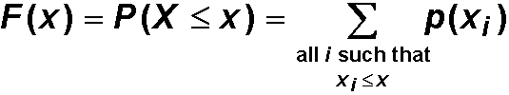
Discrete Distributions (cont’d.)
Cumulative distribution function (CDF) – probability that the RV will be ≤ a fixed value x:
Properties of discrete CDFs
  0 ≤ F(x) ≤ 1 for all x
  As x → –∞, F(x) → 0
  As x → +∞, F(x) → 1
  F(x) is nondecreasing in x
  F(x) is a step function continuous from the right with jumps at the x_{i}’s of height equal to the PMF at that x_{i}
These four properties
are also true of
continuous CDFs
Simulation with Arena, 4/e
Appendix C – A Refresher on Probability and Statistics
Slide <number> of 34

Slide 12

Discrete Distributions (cont’d.)
Computing probabilities about a discrete RV – usually use the PMF
  Add up p(x_{i}) for those x_{i}’s satisfying the condition for the event
With discrete RVs, must be careful about weak vs. strong inequalities – endpoints matter!
Simulation with Arena, 4/e
Appendix C – A Refresher on Probability and Statistics
Slide <number> of 34

Slide 13

Discrete Expected Values
Data set has a “center” – the average (mean)
RVs have a “center” – expected value
  Also called the mean or expectation of the RV X
  Other common notation: μ, μ_{X}
  Weighted average of the possible values x_{i}, with weights being their probability (relative likelihood) of occurring
  What expectation is not: The value of X you “expect” to get
    E(X) might not even be among the possible values x₁, x₂, …
  What expectation is:
    Repeat “the experiment” many times, observe many X₁, X₂, …, X_{n}
    E(X) is what converges to (in a certain sense) as n → ∞
Simulation with Arena, 4/e
Appendix C – A Refresher on Probability and Statistics
Slide <number> of 34

Slide 14





Discrete Variances and
Standard Deviations
Data set has measures of “dispersion” –
  Sample variance
  Sample standard deviation
RVs have corresponding measures
  Other common notation:
  Weighted average of squared deviations of the possible values x_{i} from the mean
  Standard deviation of X is
  Interpretation analogous to that for E(X)
Simulation with Arena, 4/e
Appendix C – A Refresher on Probability and Statistics
Slide <number> of 34

Slide 15
Continuous Distributions
Now let X be a continuous RV
  Possibly limited to a range bounded on left or right or both
  No matter how small the range, the number of possible values for X is always (uncountably) infinite
  Not sensible to ask about P(X = x) even if x is in the possible range
  Technically, P(X = x) is always 0
  Instead, describe behavior of X in terms of its falling between two values
Simulation with Arena, 4/e
Appendix C – A Refresher on Probability and Statistics
Slide <number> of 34

Slide 16


Continuous Distributions (cont’d.)
Probability density function (PDF) is a function f(x) with the following three properties:
  f(x) ≥ 0 for all real values x
  The total area under f(x) is 1:
  For any fixed a and b with a ≤ b, the probability that X will fall between a and b is the area under f(x) between a and b:
Fun facts about PDFs
  Observed X’s are denser in regions where f(x) is high
  The height of a density, f(x), is not the probability of anything – it can even be > 1
  With continuous RVs, you can be sloppy with weak vs. strong inequalities and endpoints
Simulation with Arena, 4/e
Appendix C – A Refresher on Probability and Statistics
Slide <number> of 34

Slide 17

Continuous Distributions (cont’d.)
Cumulative distribution function (CDF) - probability that the RV will be ≤ a fixed value x:
Properties of continuous CDFs
  0 ≤ F(x) ≤ 1 for all x
  As x → –∞, F(x) → 0
  As x → +∞, F(x) → 1
  F(x) is nondecreasing in x
  F(x) is a continuous function with slope equal to the PDF:
  f(x) = F'(x)
F(x) may or
may not have
a closed-form
formula
These four properties
are also true of
discrete CDFs
Simulation with Arena, 4/e
Appendix C – A Refresher on Probability and Statistics
Slide <number> of 34

Slide 18



Continuous Expected Values, Variances, and Standard Deviations
Expectation or mean of X is
  Roughly, a weighted “continuous” average of possible values for X
  Same interpretation as in discrete case: average of a large number (infinite) of observations on the RV X
Variance of X is
Standard deviation of X is
Simulation with Arena, 4/e
Appendix C – A Refresher on Probability and Statistics
Slide <number> of 34

Slide 19
Joint Distributions
So far: Looked at only one RV at a time
But they can come up in pairs, triples, …, tuples, forming jointly distributed RVs or random vectors
  Input: (T, P, S) = (type of part, priority, service time)
  Output: {W₁, W₂, W₃, …} = output process of times in system of exiting parts
One central issue is whether the individual RVs are independent of each other or related
Will take the special case of a pair of RVs (X₁, X₂)
  Extends naturally (but messily) to higher dimensions
Simulation with Arena, 4/e
Appendix C – A Refresher on Probability and Statistics
Slide <number> of 34

Slide 20

Joint Distributions (cont’d.)
Joint CDF of (X₁, X₂) is a function of two variables
  Same definition for discrete and continuous
If both RVs are discrete, define the joint PMF
If both RVs are continuous, define the joint PDF f(x₁, x₂) as a nonnegative function with total volume below it equal to 1, and
Joint CDF (or PMF or PDF) contains a lot of information – usually won’t have in practice
Simulation with Arena, 4/e
Appendix C – A Refresher on Probability and Statistics
Slide <number> of 34

Slide 21




Marginal Distributions
What is the distribution of X₁ alone? Of X₂ alone?
  Jointly discrete
    Marginal PMF of X₁ is
    Marginal CDF of X₁ is
  Jointly continuous
    Marginal PDF of X₁ is
    Marginal CDF of X₁ is
  Everything above is symmetric for X₂ instead of X₁
Knowledge of joint ⇒ knowledge of marginals – but not vice versa (unless X₁ and X₂ are independent)
Simulation with Arena, 4/e
Appendix C – A Refresher on Probability and Statistics
Slide <number> of 34

Slide 22
Covariance Between RVs
Measures linear relation between X₁ and X₂
Covariance between X₁ and X₂ is
  If large (resp. small) X₁ tends to go with large (resp. small) X₂, then covariance > 0
  If large (resp. small) X₁ tends to go with small (resp. large) X₂, then covariance < 0
  If there is no tendency for X₁ and X₂ to occur jointly in agreement or disagreement over being big or small, then Cov = 0
Interpreting value of covariance – difficult since it depends on units of measurement
Simulation with Arena, 4/e
Appendix C – A Refresher on Probability and Statistics
Slide <number> of 34

Slide 23

Correlation Between RVs
Correlation (coefficient) between X₁ and X₂ is
  Has same sign as covariance
  Always between –1 and +1
  Numerical value does not depend on units of measurement
  Dimensionless – universal interpretation
Simulation with Arena, 4/e
Appendix C – A Refresher on Probability and Statistics
Slide <number> of 34

Slide 24
Independent RVs
X₁ and X₂ are independent if their joint CDF factors into the product of their marginal CDFs:
  Equivalent to use PMF or PDF instead of CDF
Properties of independent RVs:
  They have nothing (linearly) to do with each other
  Independence ⇒ uncorrelated
    But not vice versa, unless the RVs have a joint normal distribution
  Important in probability – factorization simplifies greatly
  Tempting just to assume it whether justified or not
Independence in simulation
  Input: Usually assume separate inputs are indep. – valid?
  Output: Standard statistics assumes indep. – valid?!?!?!?
Simulation with Arena, 4/e
Appendix C – A Refresher on Probability and Statistics
Slide <number> of 34

Slide 25
Sampling
Statistical analysis – estimate or infer something about a population or process based on only a sample from it
  Think of a RV with a distribution governing the population
  Random sample is a set of independent and identically distributed (IID) observations X₁, X₂, …, X_{n} on this RV
  In simulation, sampling is making some runs of the model and collecting the output data
  Don’t know parameters of population (or distribution) and want to estimate them or infer something about them based on the sample
Simulation with Arena, 4/e
Appendix C – A Refresher on Probability and Statistics
Slide <number> of 34

Slide 26
Sampling (cont’d.)
Population parameter
  Population mean μ = E(X)
  Population variance σ²
  Population proportion
Parameter – need to know whole population
Fixed (but unknown)
Sample estimate
  Sample mean
  Sample variance
  Sample proportion
Sample statistic – can be computed from a sample
Varies from one sample to another – is a RV itself, and has a distribution, called the sampling distribution
Simulation with Arena, 4/e
Appendix C – A Refresher on Probability and Statistics
Slide <number> of 34

Slide 27




Sampling Distributions
Have a statistic, like sample mean or sample variance
  Its value will vary from one sample to the next
Some sampling-distribution results
  Sample mean
  If
  Regardless of distribution of X,
  Sample variance s²
  E(s²) = σ²
  Sample proportion
  E( ) = p
Simulation with Arena, 4/e
Appendix C – A Refresher on Probability and Statistics
Slide <number> of 34

Slide 28
Point Estimation
A sample statistic that estimates (in some sense) a population parameter
Properties
  Unbiased: E(estimate) = parameter
  Efficient: Var(estimate) is lowest among competing point estimators
  Consistent: Var(estimate) decreases (usually to 0) as the sample size increases
Simulation with Arena, 4/e
Appendix C – A Refresher on Probability and Statistics
Slide <number> of 34

Slide 29
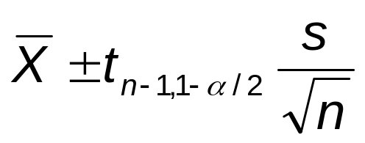
Confidence Intervals
A point estimator is just a single number, with some uncertainty or variability associated with it
Confidence interval quantifies the likely imprecision in a point estimator
  An interval that contains (covers) the unknown population parameter with specified (high) probability 1 – α
  Called a 100 (1 – α)% confidence interval for the parameter
Confidence interval for the population mean μ:
CIs for some other parameters – in text
t_{n-1,1-α/2} is point below which is area
1 – α/2 in Student’s t distribution with
n – 1 degrees of freedom
Simulation with Arena, 4/e
Appendix C – A Refresher on Probability and Statistics
Slide <number> of 34

Slide 30
Confidence Intervals in Simulation
Run simulations, get results
View each replication of the simulation as a data point
Random input ⇒ random output
Form a confidence interval
Brackets (with probability 1 – α) the “true” expected output (what you’d get by averaging an infinite number of replications)
Simulation with Arena, 4/e
Appendix C – A Refresher on Probability and Statistics
Slide <number> of 34

Slide 31
Hypothesis Tests
Test some assertion about the population or its parameters
Can never determine truth or falsity for sure – only get evidence that points one way or another
Null hypothesis (H₀) – what is to be tested
Alternate hypothesis (H₁ or H_{A}) – denial of H₀
  H₀: μ = 6 vs. H₁: μ ≠ 6
  H₀: σ < 10 vs. H₁: σ ≥ 10
  H₀: μ₁ = μ₂ vs. H₁: μ₁ ≠ μ₂
Develop a decision rule to decide on H₀ or H₁ based on sample data
Simulation with Arena, 4/e
Appendix C – A Refresher on Probability and Statistics
Slide <number> of 34

Slide 32
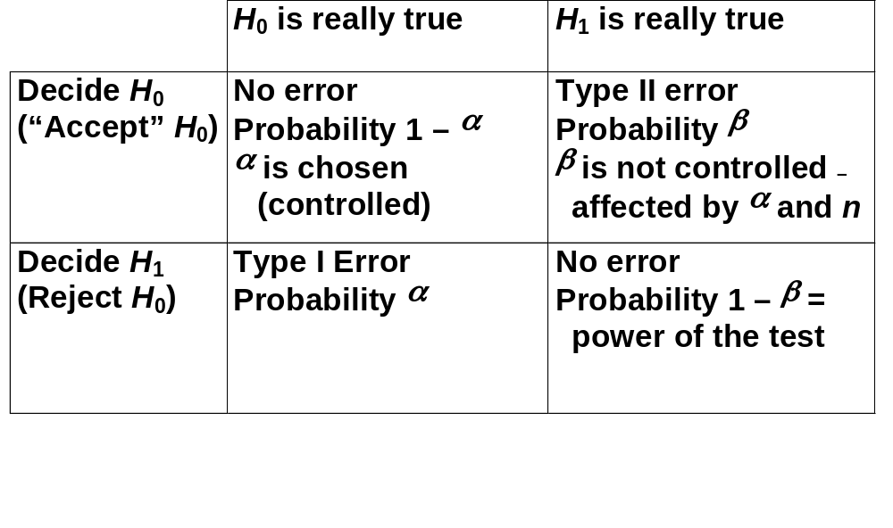
Errors in Hypothesis Testing
Simulation with Arena, 4/e
Appendix C – A Refresher on Probability and Statistics
Slide <number> of 34

Slide 33
p-Values for Hypothesis Tests
Traditional method is “Accept” or Reject H₀
Alternate method – compute p-value of the test
  p-value = probability of getting a test result more in favor of H₁ than what you got from your sample
  Small p (like < 0.01) is convincing evidence against H₀
  Large p (like > 0.20) indicates lack of evidence against H₀
Connection to traditional method
  If p < α, reject H₀
  If p ≥ α, do not reject H₀
p-value quantifies confidence about the decision
Simulation with Arena, 4/e
Appendix C – A Refresher on Probability and Statistics
Slide <number> of 34

Slide 34
Hypothesis Testing in Simulation
Input side
  Specify input distributions to drive the simulation
  Collect real-world data on corresponding processes
  “Fit” a probability distribution to the observed real-world data
  Test H₀: the data are well represented by the fitted distribution
Output side
  Have two or more “competing” designs modeled
  Test H₀: all designs perform the same on output, or test H₀: one design is better than another
  Selection of a “best” model scenario
Simulation with Arena, 4/e
Appendix C – A Refresher on Probability and Statistics
Slide <number> of 34

